Slide 1

Holman Garden Lighting
Irrigation - Garden – Plumbing

Slide 2


An introduction to Holman
I
Irrigation
Export Internationally through DIG and K-Rain to Home Depot
50 Years Young
G
Garden Decor
3 Offices
Perth,
Melbourne,
Brisbane
Australian Family Owned
P
Plumbing
4 Warehouses
Perth,
Melbourne,
Brisbane,
Sydney
Designed & Engineered
in Australia
140 + Employees

Slide 3
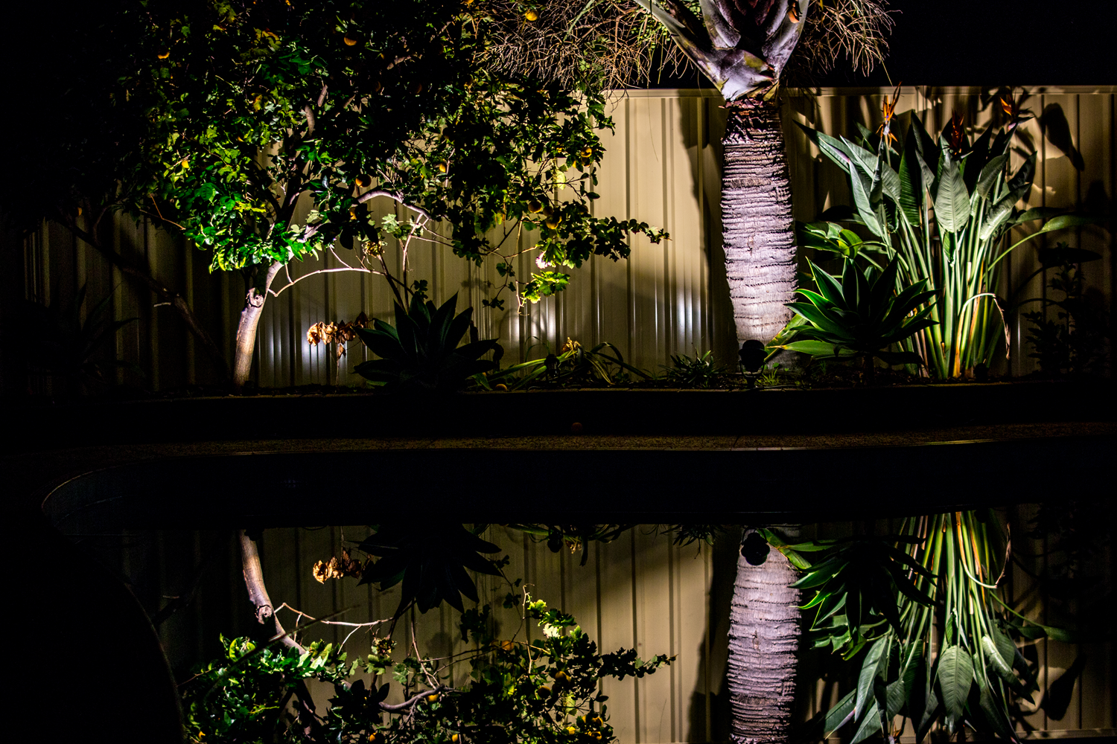
Holman Garden lighting
Enjoy your garden after sundown
Improve ambience
Highlight certain plants
Wall wash for background effect

Slide 4
Holman Garden lighting
Features:
LED for efficiency
12V for safety
Water resistant connections
White or colour option
Bluetooth control
DIY

Slide 5
Holman garden lighting
What’s on offer

Slide 6
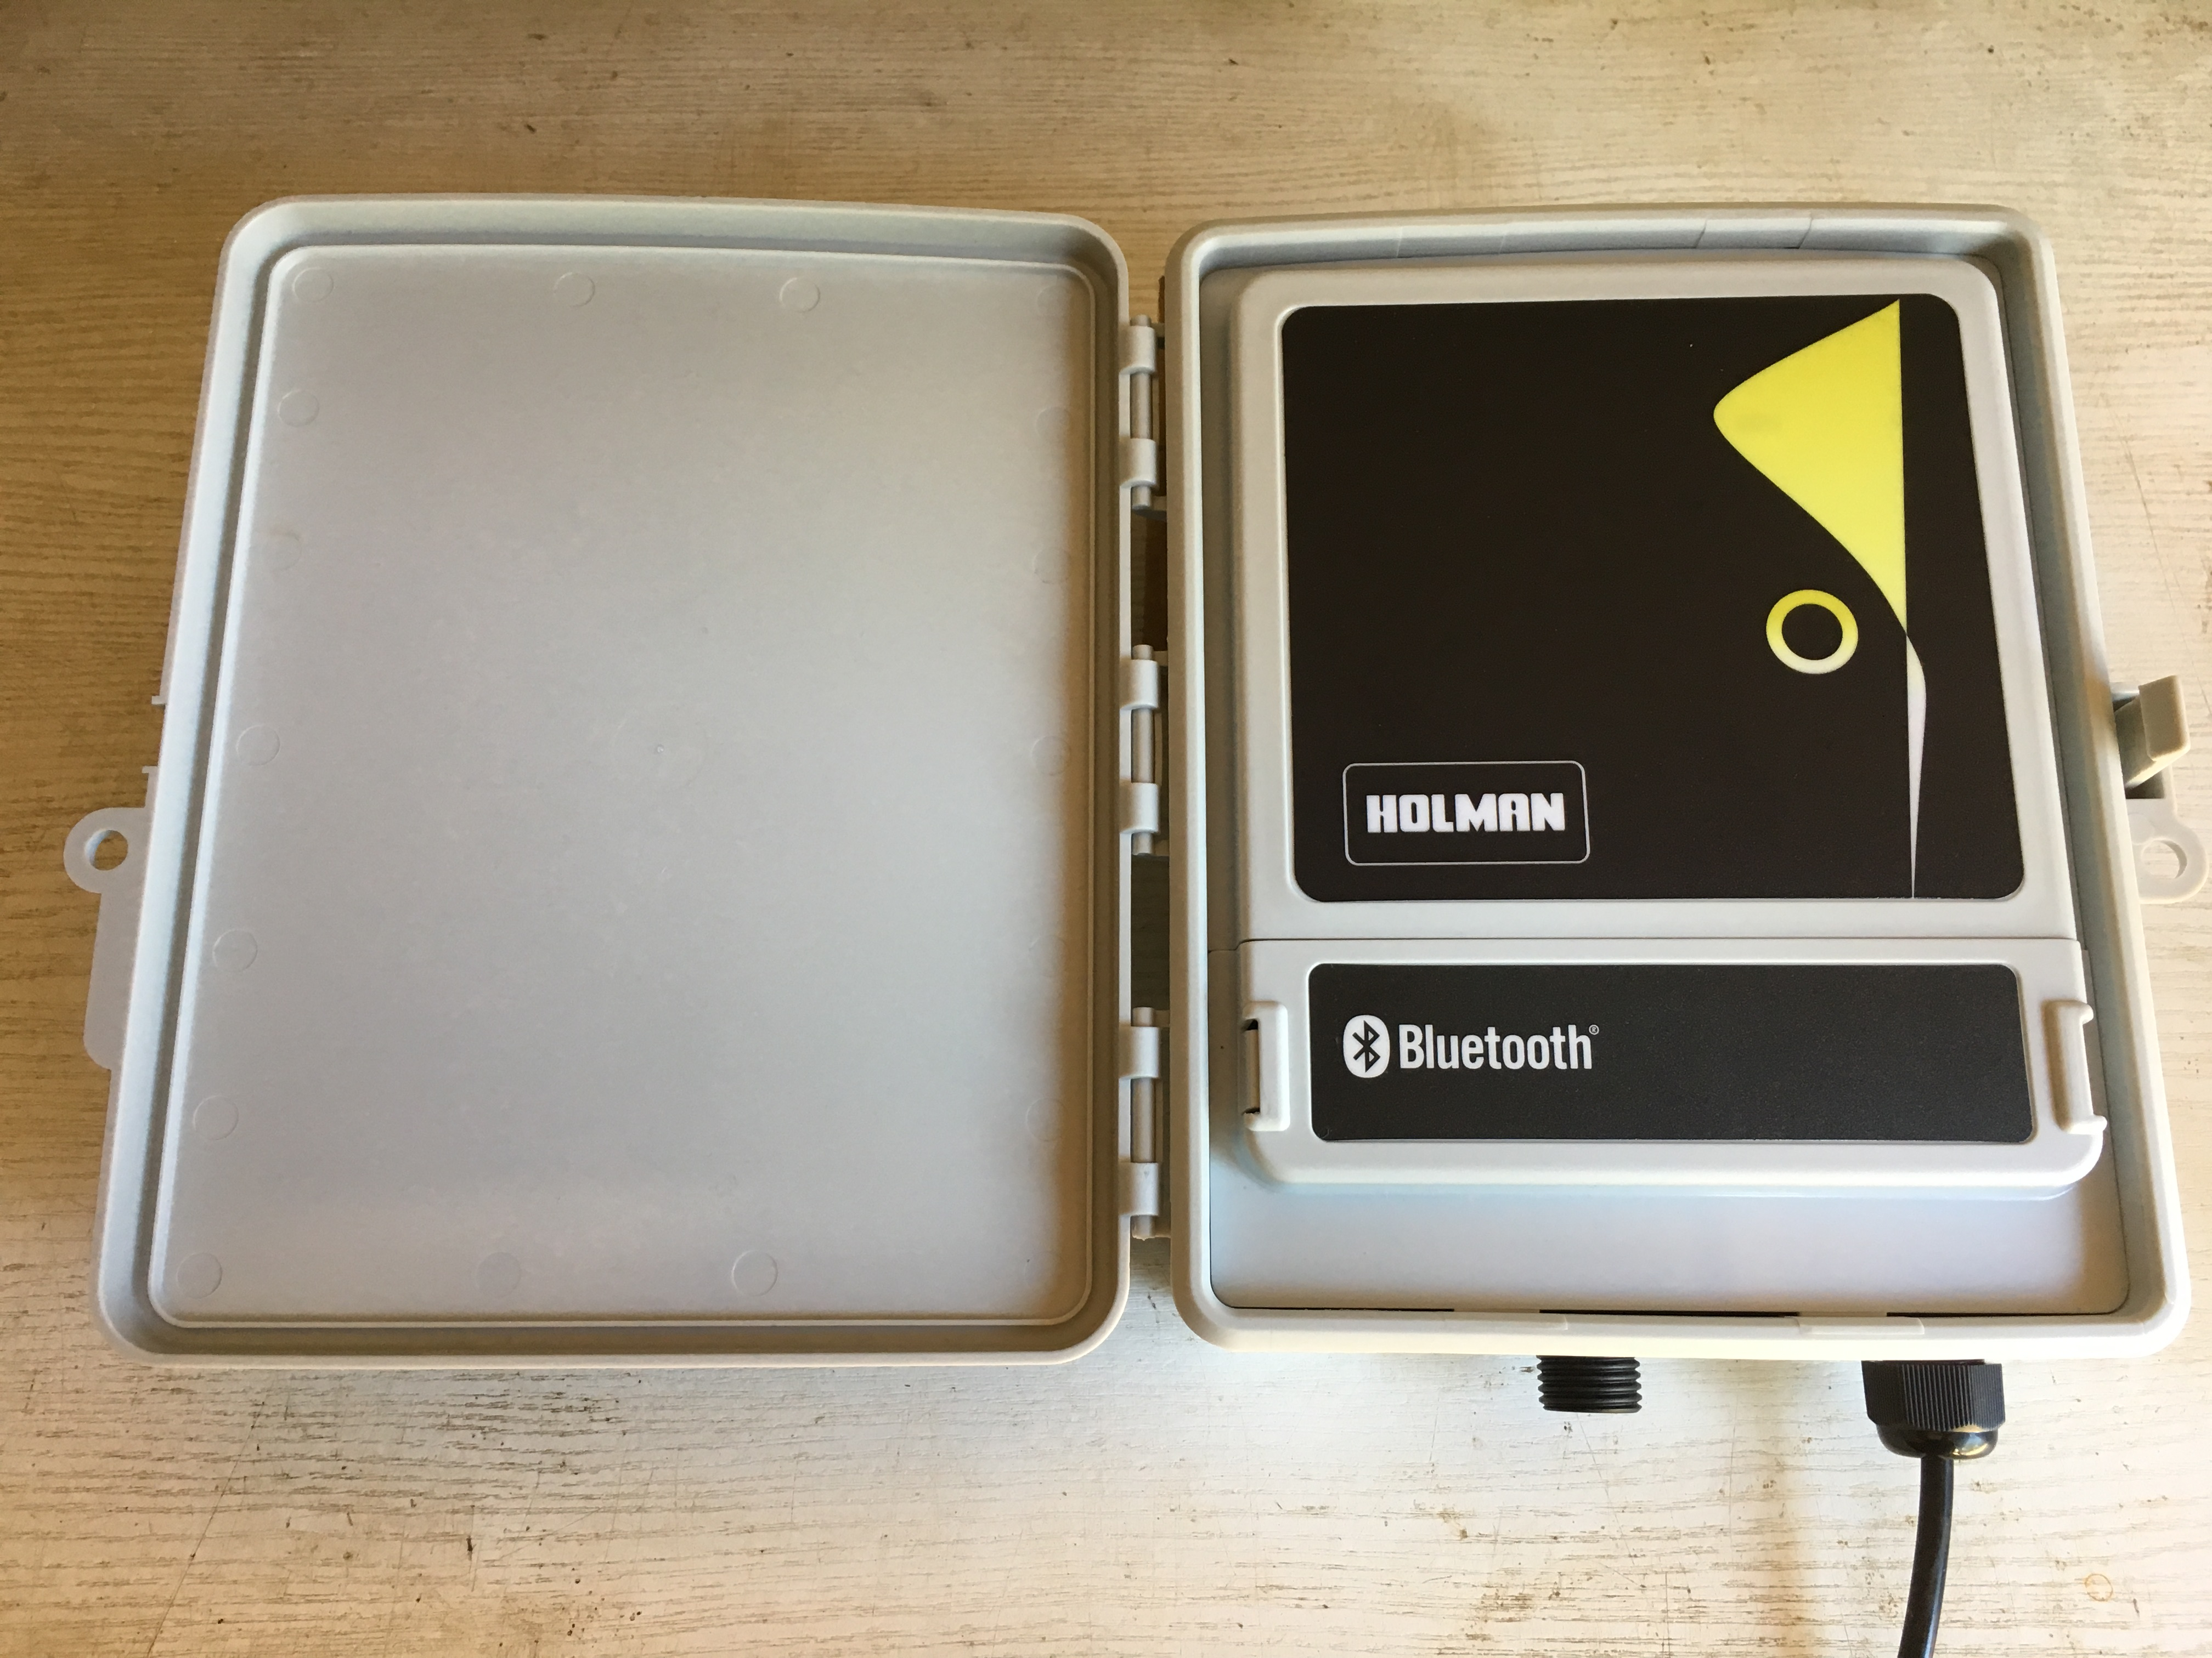
controllers

Slide 7
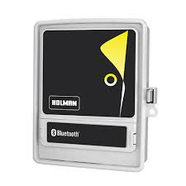
All transform 240V to 12V
All 60W
Manual white $49.98
Blue tooth white $99
Blue tooth colour $129

Slide 8
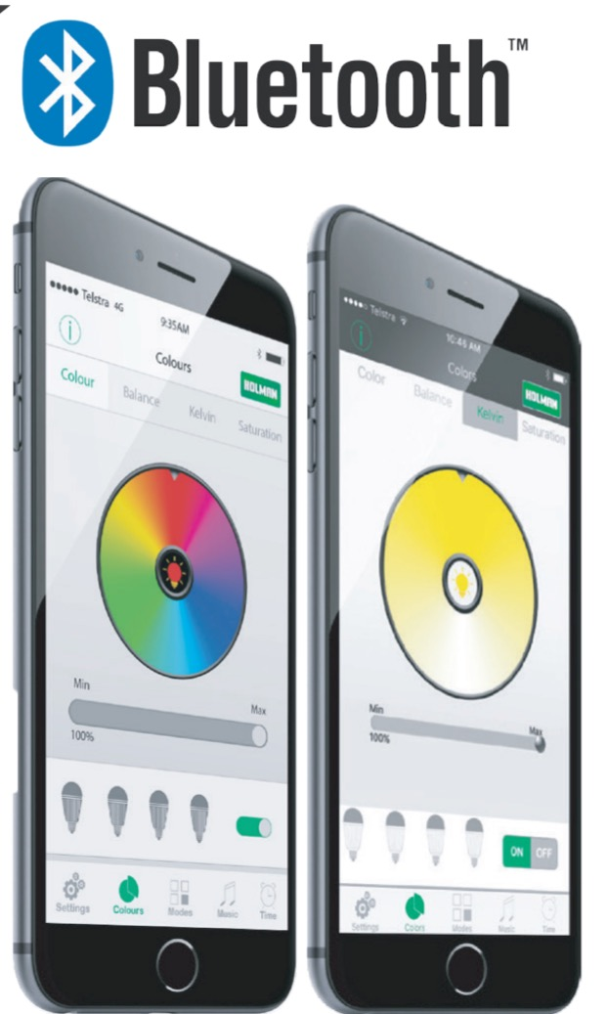
Why choose Bluetooth?
Adjust the lighting from the comfort of your lounge
Turn lights on from your car in the driveway
Turn lights on an off for visitors and guests
Set the mood for a garden party
Adjust lighting to suit the music playing
Set on and off times
The possibilities are endless

Slide 9
Why choose colour?
RGB Colour
Change lights to any colour on the spectrum
Colours can vary with time
4-pin plug and socket connection
Warm White
Dimmable to vary brightness
Larger light options
2-pin plug and socket system
White and colour lights cannot be connected on the same system

Slide 10
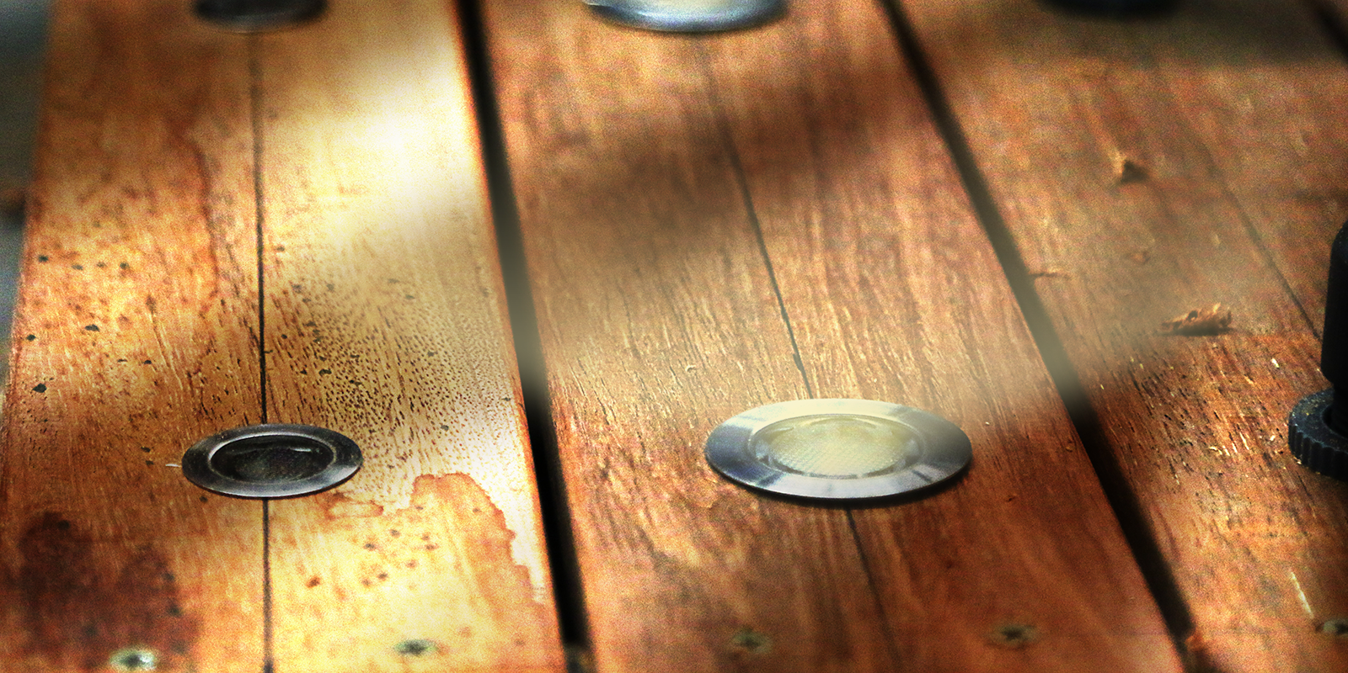
Deck lights

Slide 11
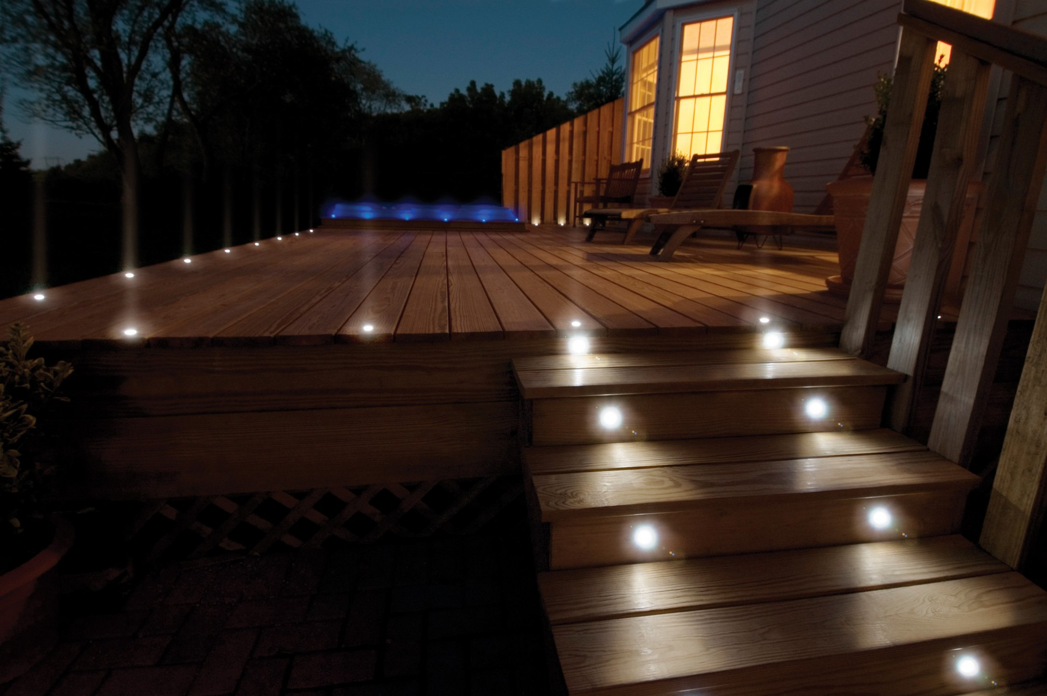
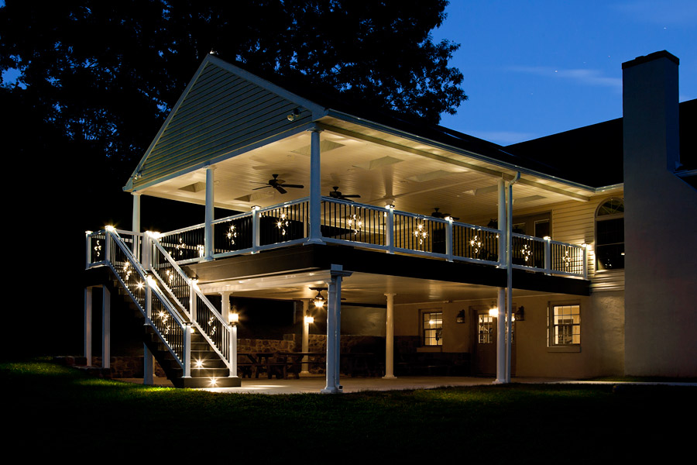
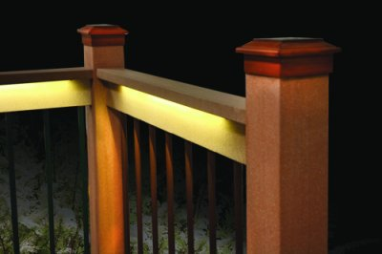
DECK LIGHTS
Illuminate stairs, bannisters and entry ways
Softly light patios and gazebos
Shed light from hidden source

Slide 12
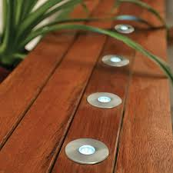
White 30mm $49.97 for 6
White 45mm $59.97 for 6
Colour 30mm $59.98 for 6
Colour 45mm $69.98 for 6

Slide 13
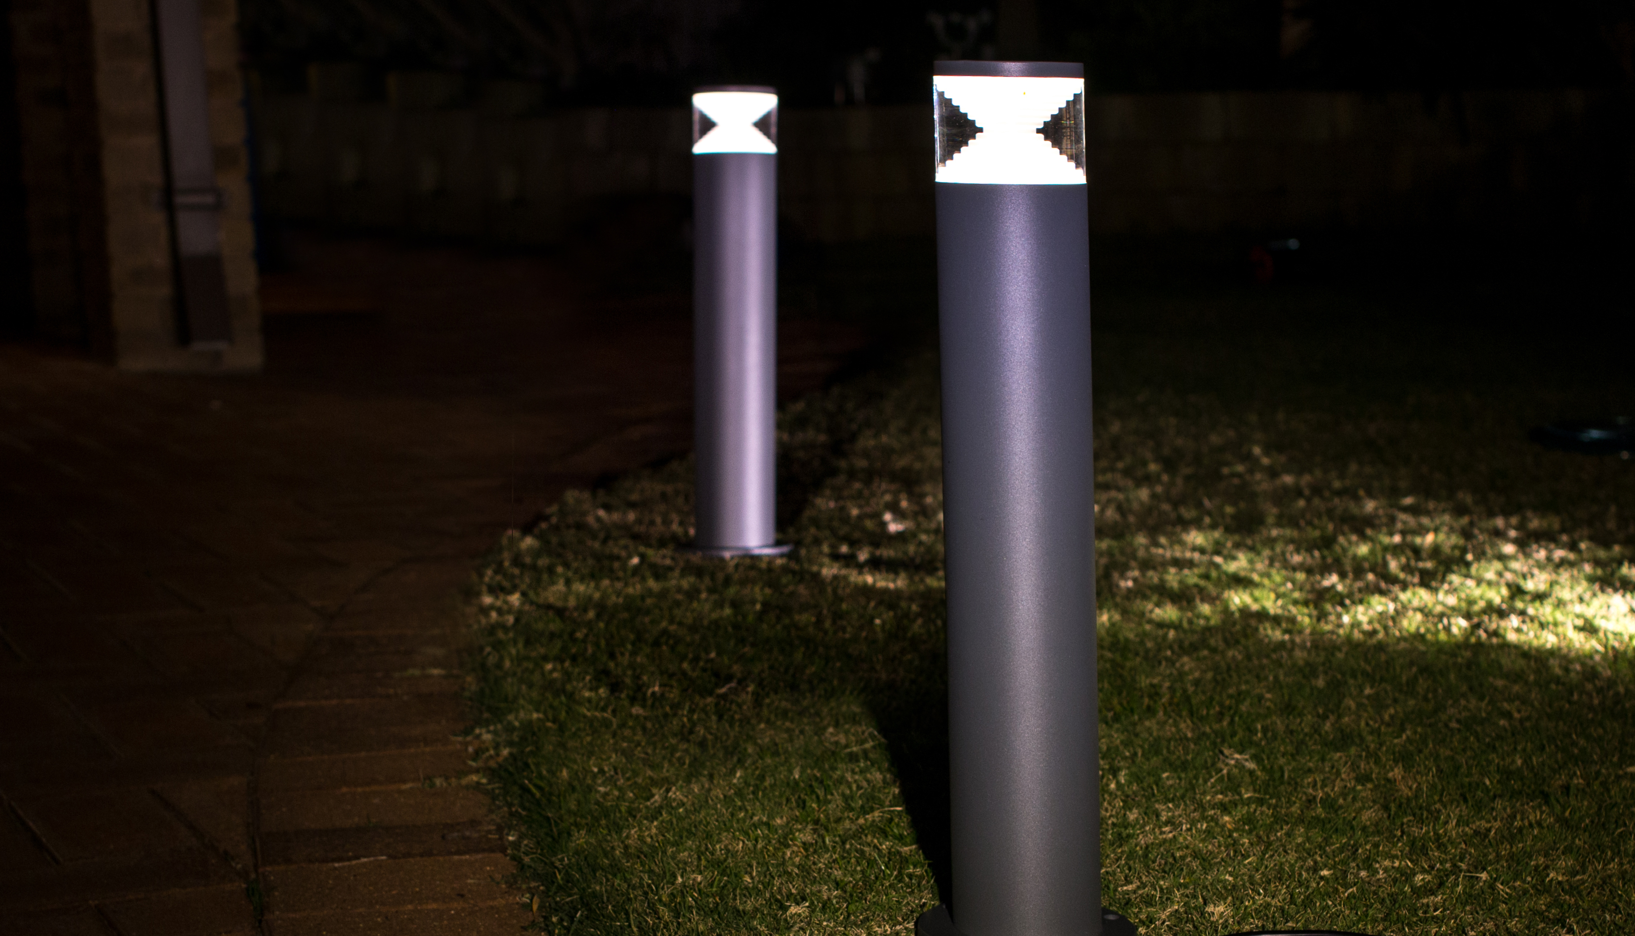
Path lights

Slide 14
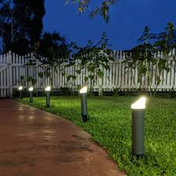
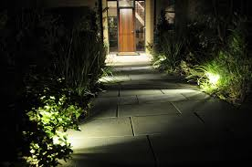
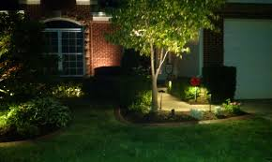
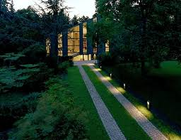
PATH LIGHTS
Light Paths, drives, entry ways
Out on display, or hidden from view
Cables can be buried under lawn or hidden around shrubbery

Slide 15
Place with garden spike or bolted base
White 250mm $39.98
White 450mm $59.98
White 550mm $69.98
Colour 250mm $49.98

Slide 16
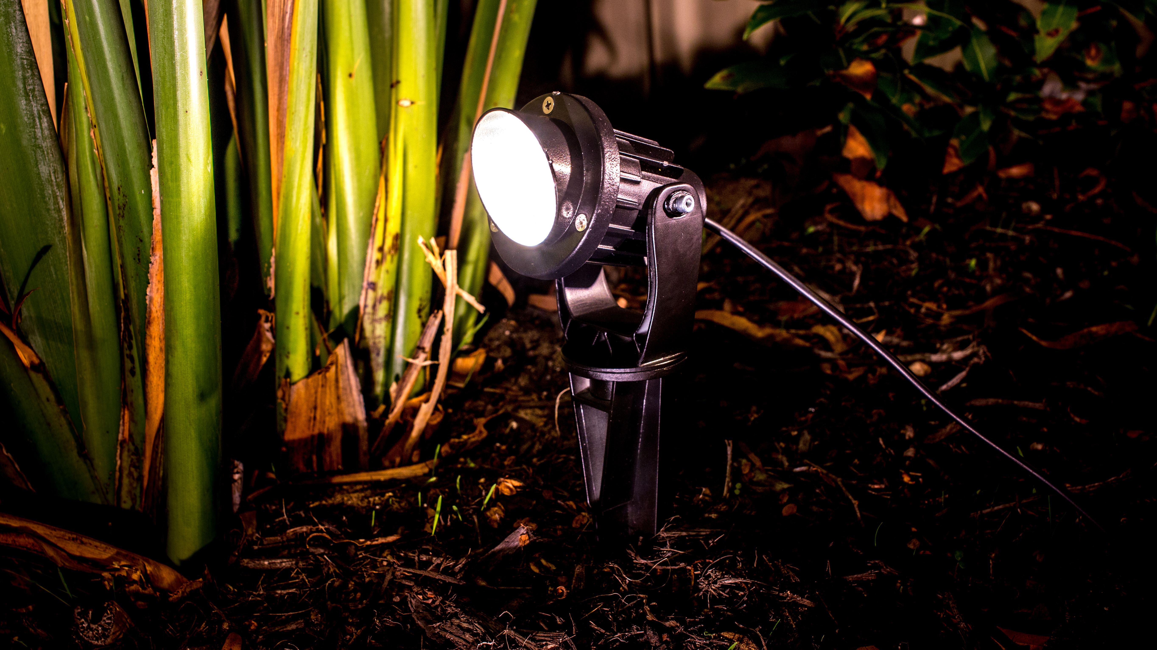
spotlights

Slide 17
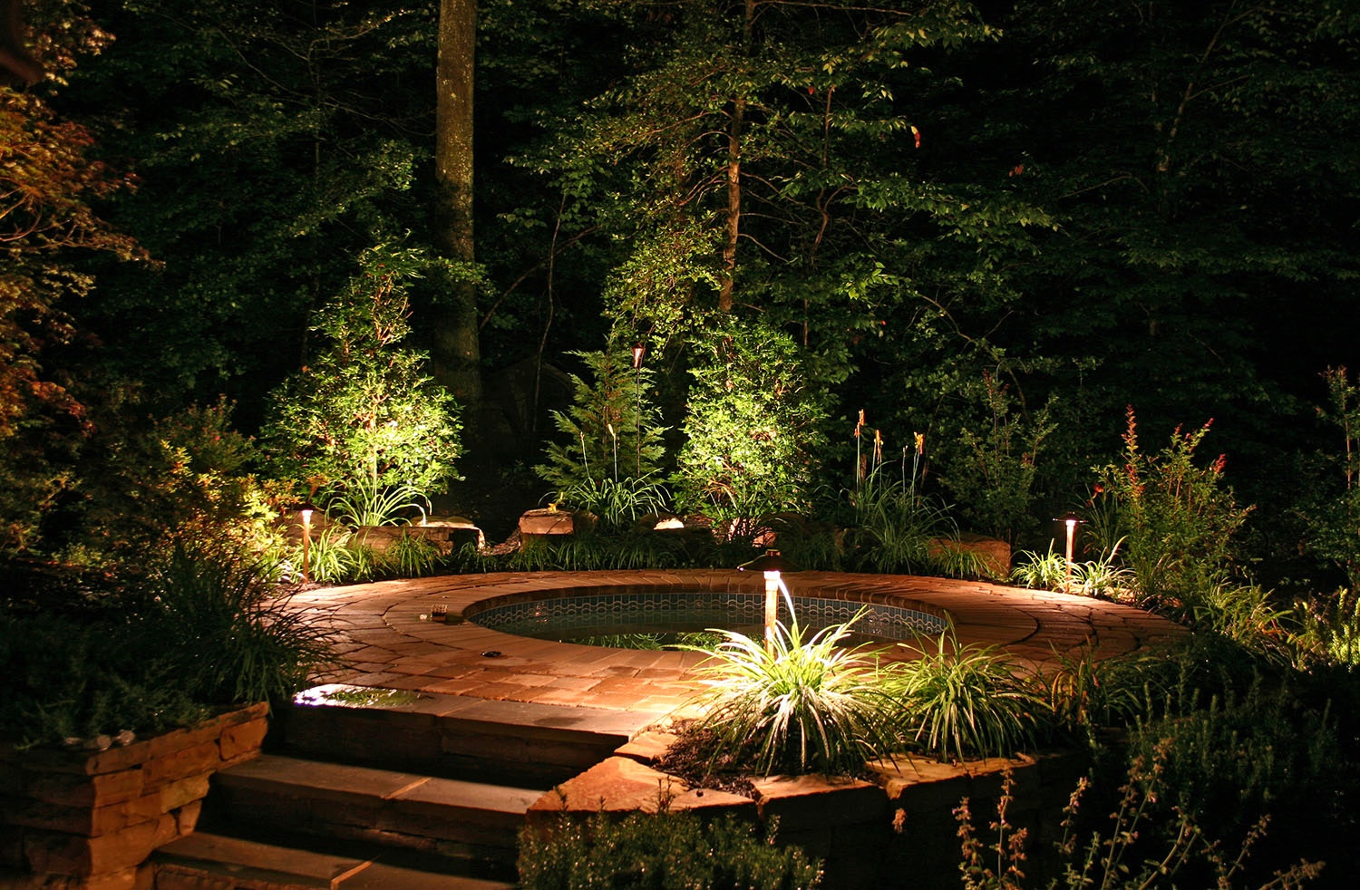
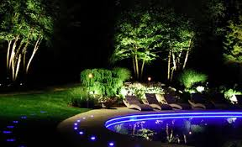
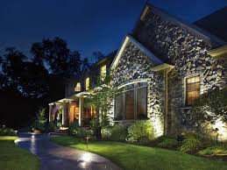
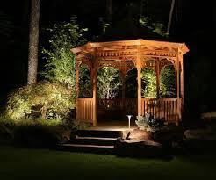
SPOTLIGHTS
Highlight foliage of trees
Wall wash for background
Illuminate structures from hidden sources

Slide 18
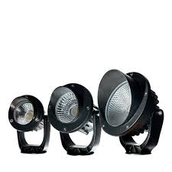
White 43mm $22.98
White 75mm $29.98
White 100mm $49.98
White 140mm $64.98
Colour 43mm $31.98
Colour 75mm $39.98
Colour 100mm $59.98

Slide 19
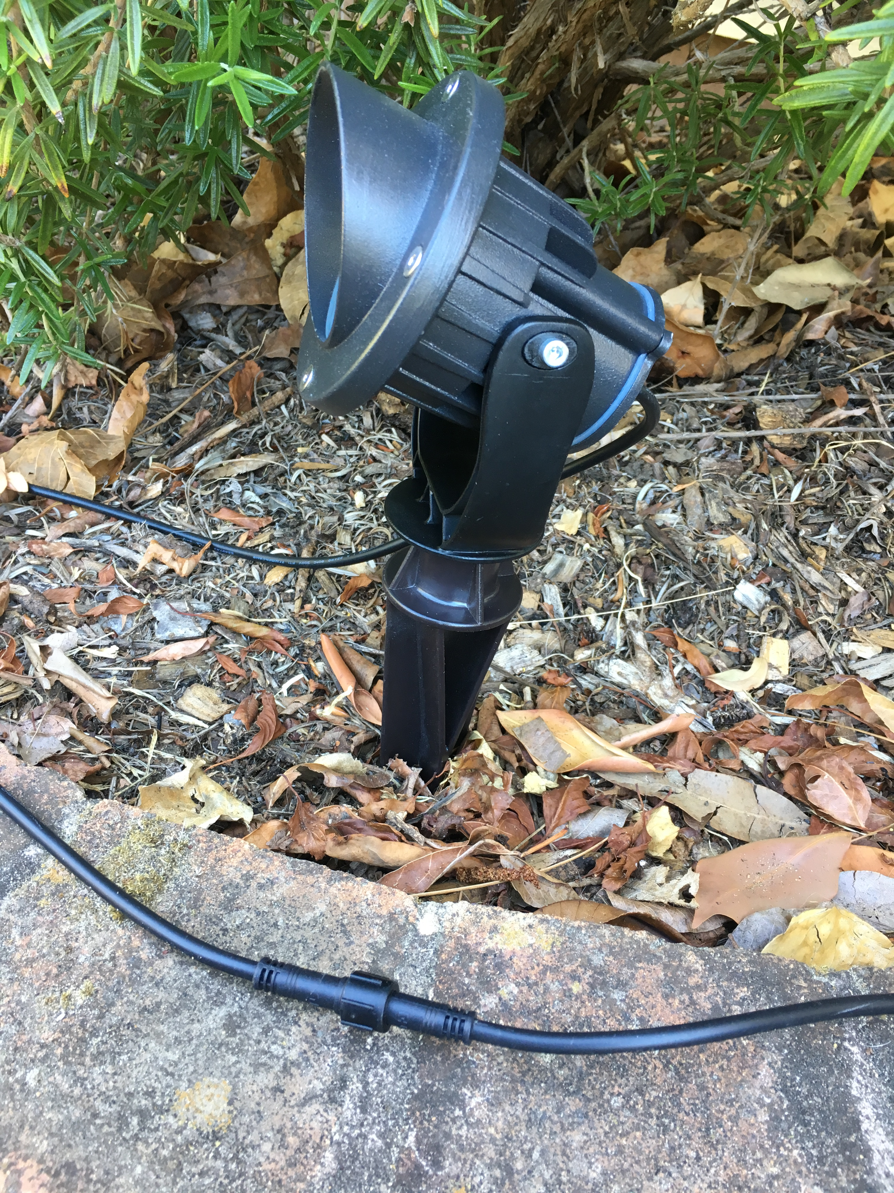
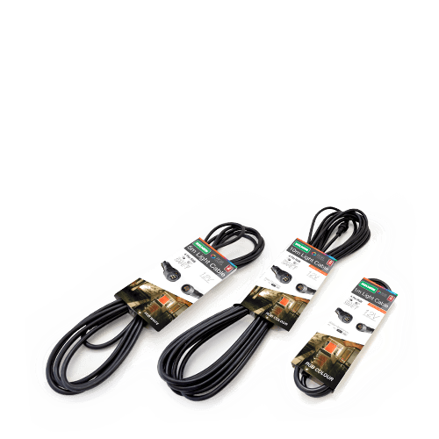
CABLES
Ingress Protection (IP rating)
Submersible cables carry rating IP 68
Our cable connections are rated IP67
Safe outside all year round.
White
1m $6.98
5m $18.98
10m $34.98
Tee $9.98
Colour
1m $9.98
5m $24.98
10m $49.98
Tee $14.98

Slide 20
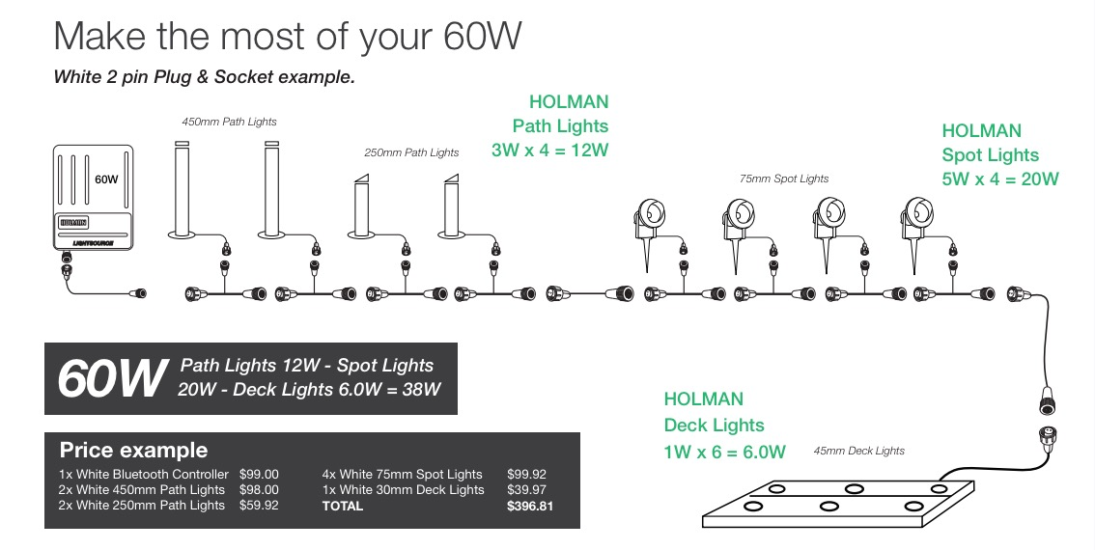
How it goes together

Slide 21
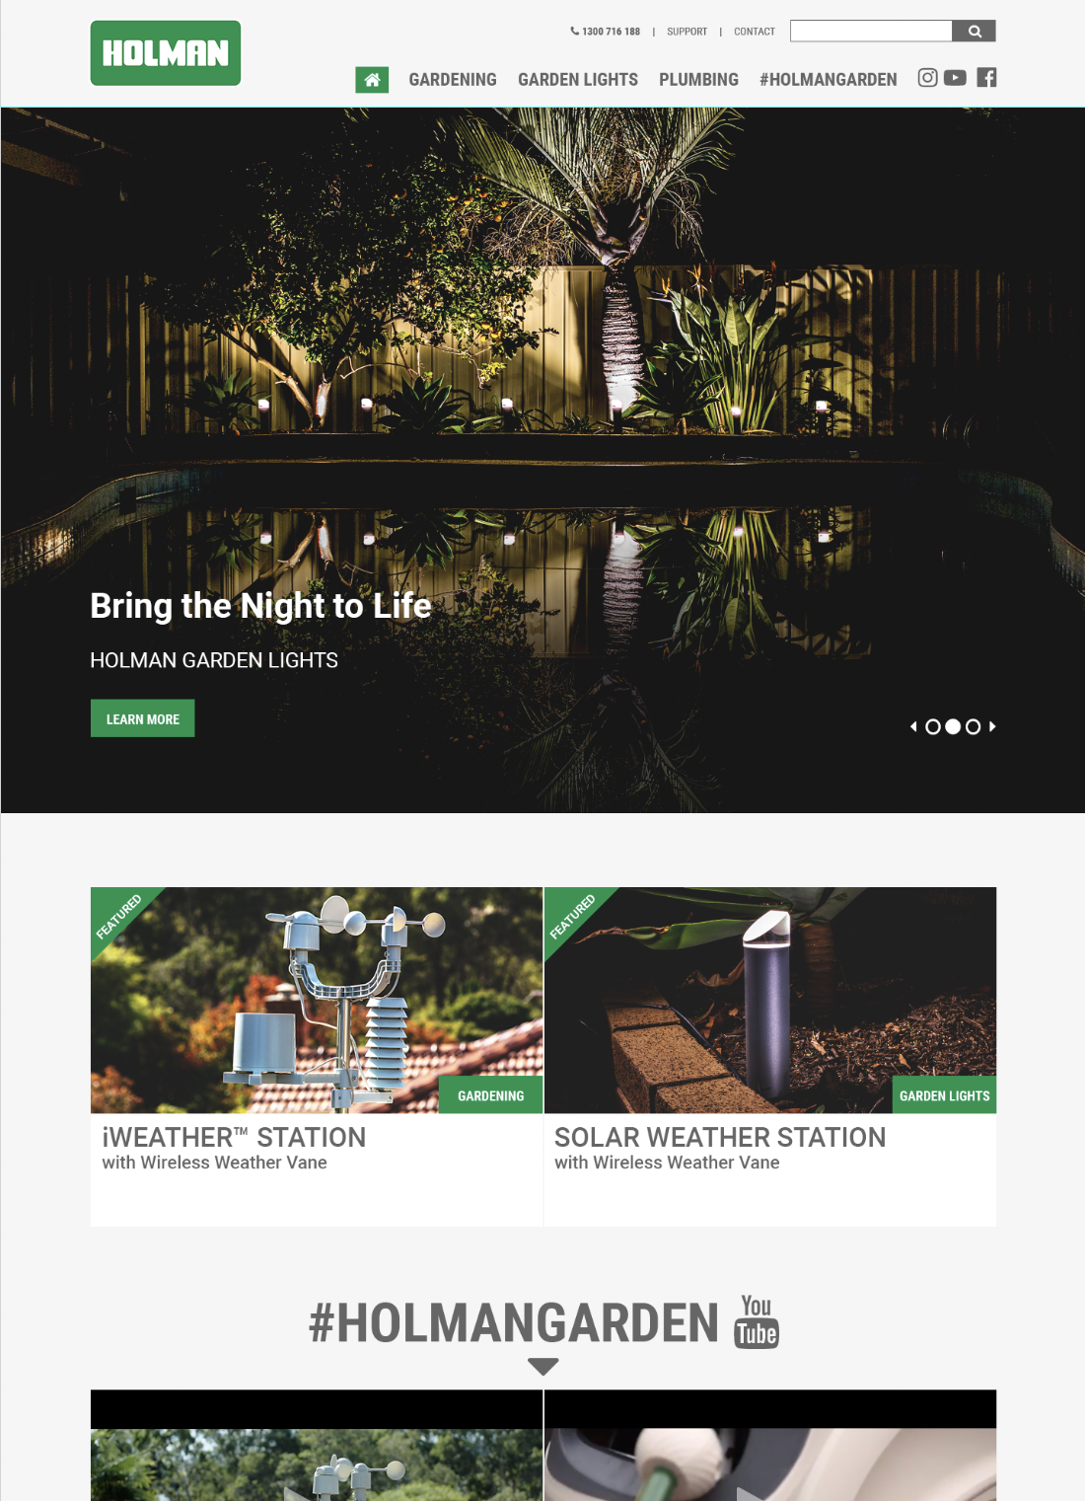
Holman Website
More information can be obtained at our website
Tech sheets
Training videos
Holmanindustries.com.au

Slide 22
THANK YOU
Irrigation - Garden – Plumbing

